Slide 1
Automating Fruit Quality Determination
For Industrial Applications
Session 2022-23
Submitted By :
Lakshya Gour (19I71__)
Ritik K. Koshta (19I71__)
Udbhav Gupta (19I7165)
Guided By :
Mr. C. P. Patidar

Slide 2
Presentation Outline
Problem Domain
Technology and Tools
Existing Solutions
Analysing Use Case
Solution Domain
Application Snapshots
Demonstration
References

Slide 3
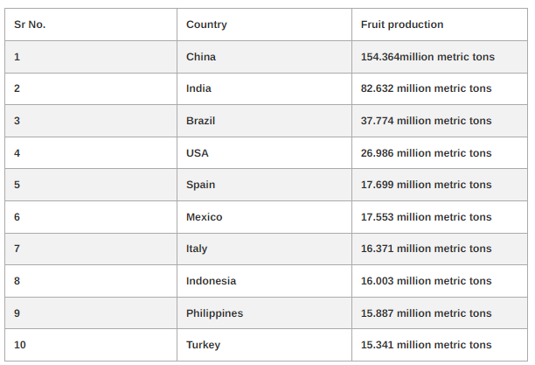
Problem Domain
Top 10 Fruit Producing Countries (2022)
India is the second largest producer of fruits.
Yearly Production of about 82.632 million .
[Image Source : https://www.edudwar.com/top-10-fruit-producing-countries]

Slide 4
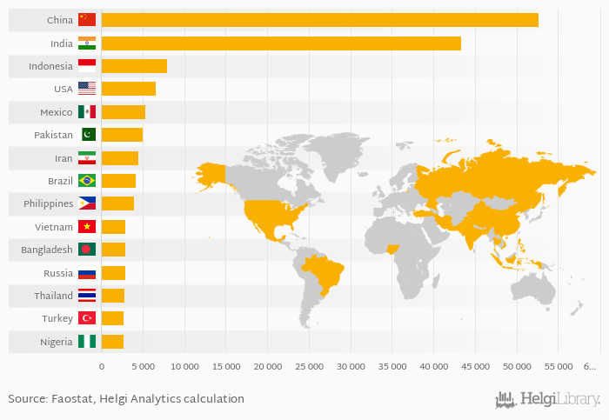
Problem Domain
Global Fruit Consumption Statistics 2019 (in kt)
India is the second largest consumer of fruits.
Yearly Consumption of about 52,685 kt.
[Image Source : https://www.helgilibrary.com/charts/which-country-eats-the-most-fruits]

Slide 5
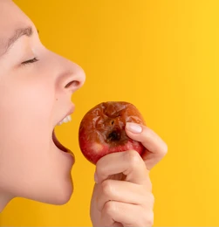
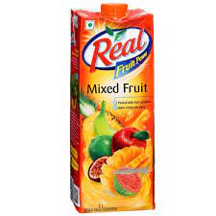
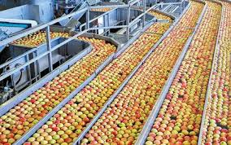
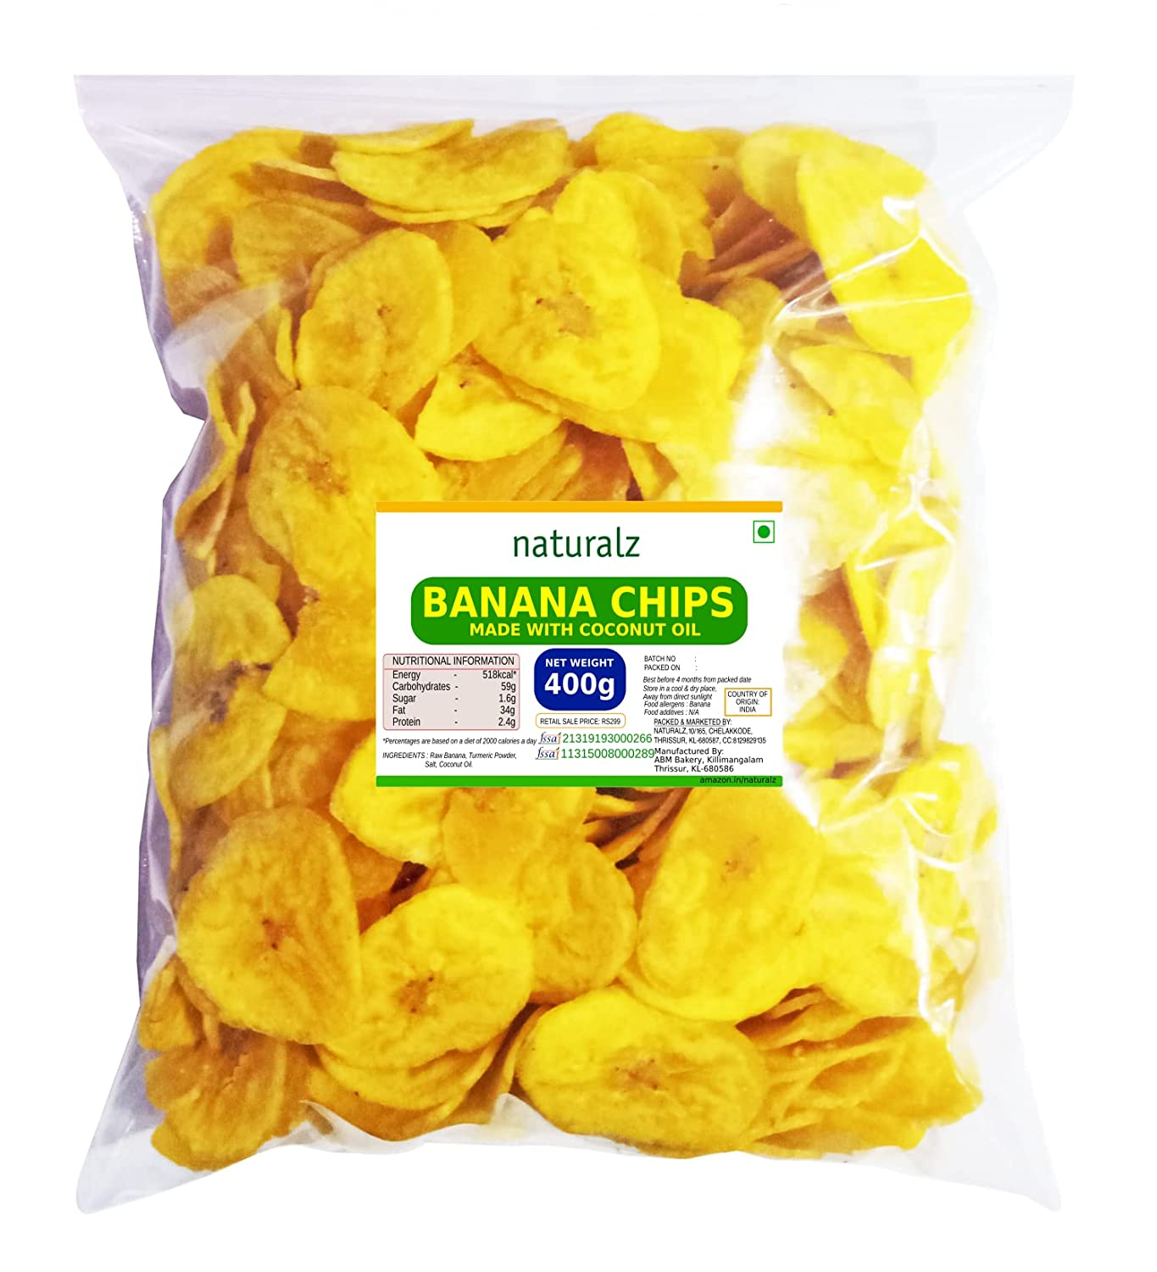
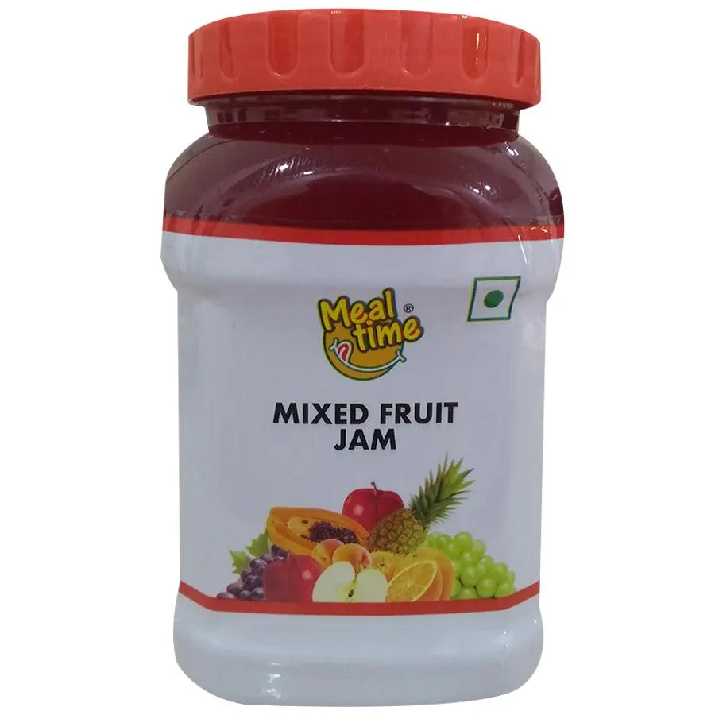
Problem Domain
Fruit Quality Inspection : A Major Concern
Are the fruits consumed by end customers fresh?
A large chunk of fruit produce is taken up by the fruit processing companies, for making variety of readymade products such as fruit drinks, syrups, cakes, etc..
Notes:
What happens if rotten fruits are used?

Slide 6
Problem Domain
Fruit Quality Inspection : A Major Concern
What makes a fruit to decay so fast?
As the fruit matures, ethylene is produced as a signal to induce fruit ripening.
Transforms it from hard, green, dull fruit into a tender, gaudy and sweet.
Ethylene production continues to increase after harvest, thus decreasing fruit shelf-life.
Shelf-life of:
Apple : 2 Weeks
Orange : 1 Week
Banana : 3 to 5 Days
Notes:
This makes it more important to check if the fruit used is fresh or rotten.
Ethylene : colorless gas

Slide 7
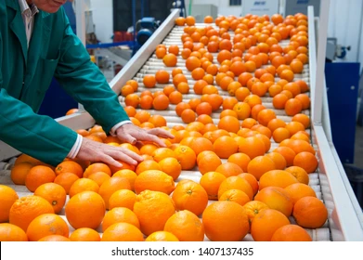
Existing Solutions
Most common method presently being used is the manual inspection of fruits by human workforce.
These manual methods for segmentation of fruits are either slow and less accurate.
This process can be automated.

Slide 8
Existing Solutions
Earlier, many research work has been done in the context of using Image Processing and Machine Learning to automate the process sorting fresh and rotten fruits.
Various Supervised Machine Learning Classifiers such as KNN,

